Slide 1
ACCY577 Machine Learning for Accounting
Module 1: Introduction to Machine Learning
Linden Lu

Slide 2
Lesson 1: Introduction to Machine Learning
Artificial Intelligence, Machine Learning and Deep Learning
Machine Learning Algorithms

Slide 3
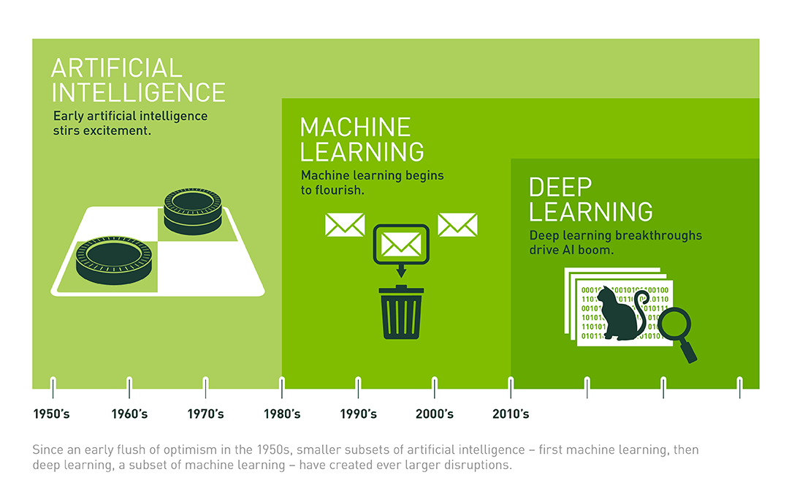
Artificial Intelligence, Machine Learning and Deep Learning

Slide 4
Machine Learning
Supervised Learning
Classification
Regression
Unsupervised Learning
Clustering

Slide 5
Machine Learning Algorithms
Classification
Regression
Text Analysis
Clustering
Time Series Analysis

Slide 6

Lesson 2: Data Pre-Processing

Slide 7
Data Pre-processing Techniques
Categorical Variables Encoding
Dataset Splitting
Data Scaling and Standardizing

Slide 8
Categorical Variables
Nominal
Categories have no numerical orders.
Gender, Color
Ordinal
Categories have numerical orders.
Rank in race, Size

Slide 9
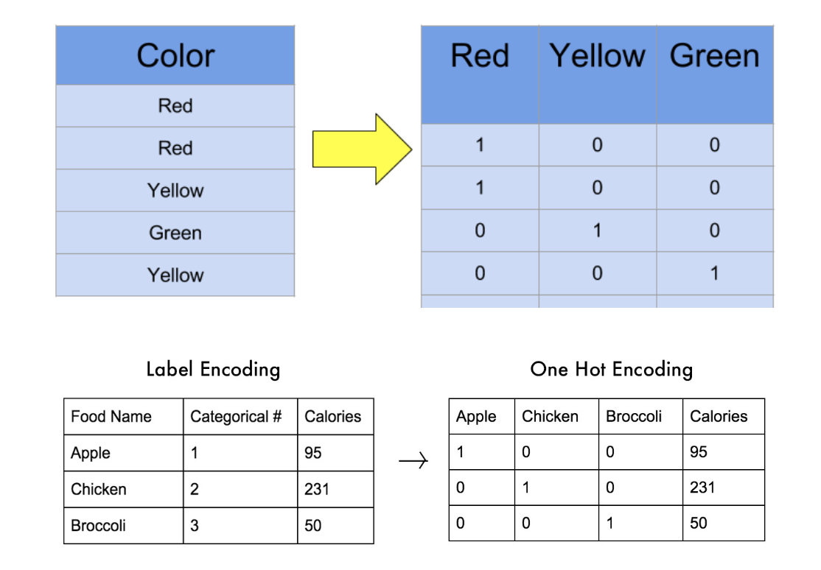
Categorical Variable Encoding
Label Encoding
Encode to unique numeric values.
One Hot Encoding
Create a dummy variable with value 0 and 1
for each category value.
Ordinal Encoding
Encode categories to ordered numerica values.
Small->0, Medium->1, Large->2

Slide 10
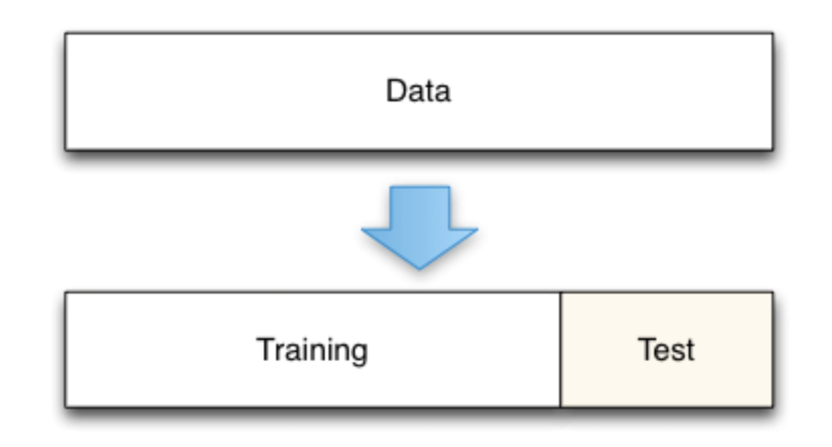
Dataset Splitting

Slide 11
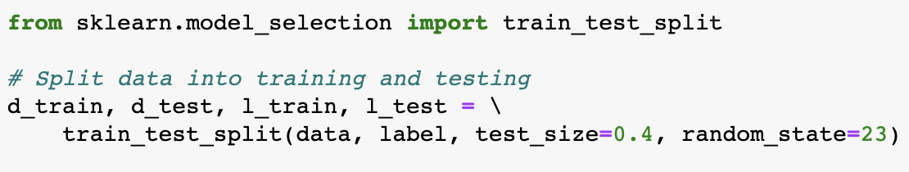
Dataset Splitting

Slide 12
Data Scaling
Standardizing
Zero mean and one standard deviation
Normalization
Scale to same range, normally 0 to 1

Slide 13
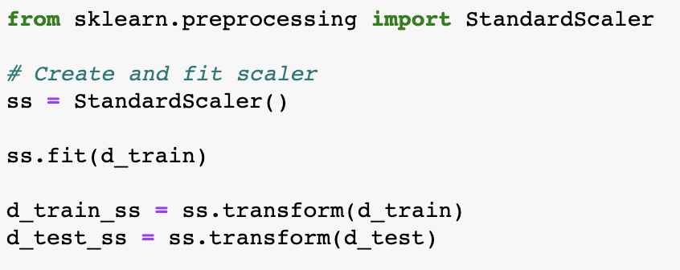
Data Scaling

Slide 14
Lesson 3: Introduction to Machine Learning Algorithms
Modeling with Scikit-Learn
Pre-process data
Create Model
Train the model
Evaluate the model
Predict with the model

Slide 15
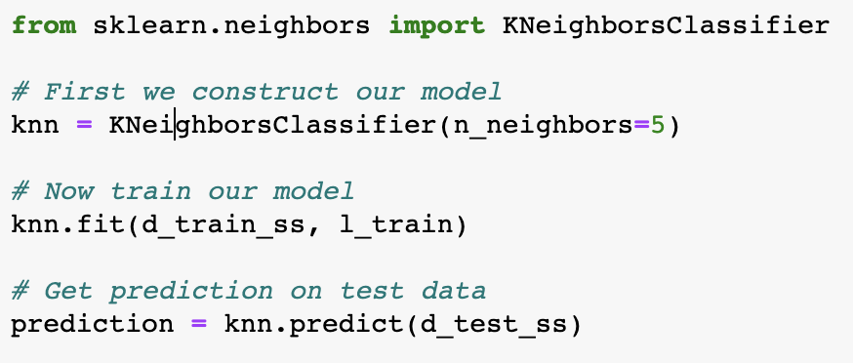
Modeling with Scikit-Learn

